Slide 1
CNCE 250 Computer Architecture Lab session
TA : 이종민
flackekd@korea.ac.kr

Slide 2
Contents
Lab03 multiplexer, decoder

Slide 3
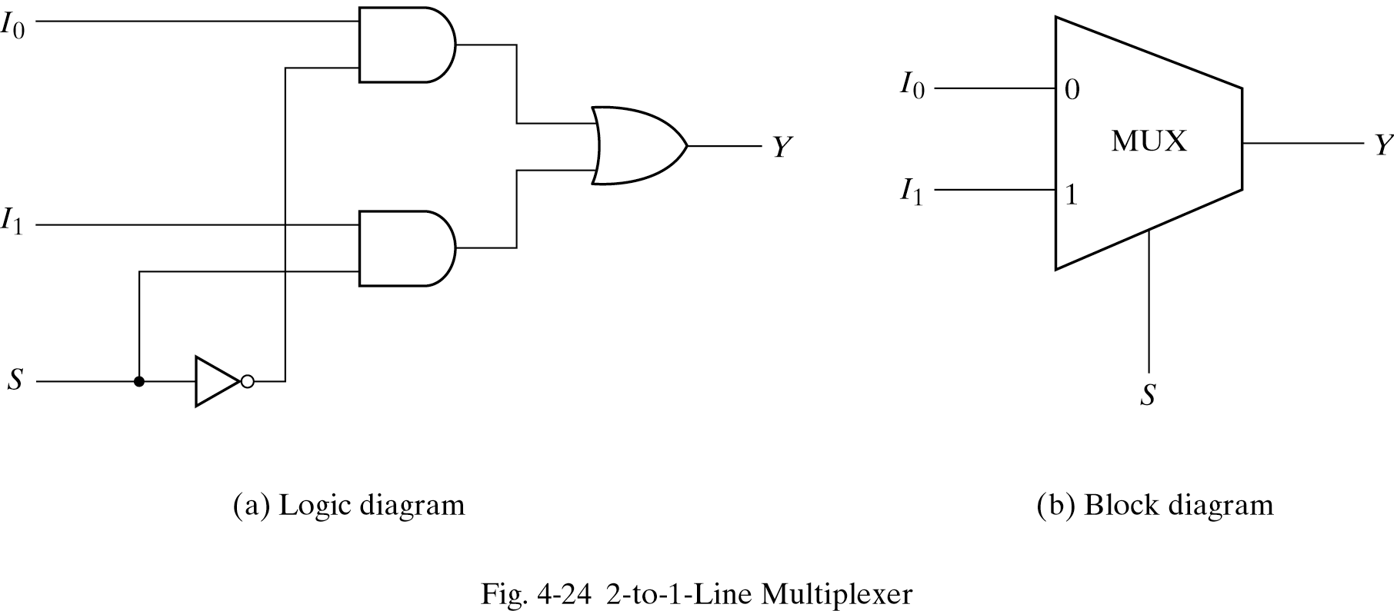
Gate Level Modeling (cont’)
ex) 2:1 Mutiplexer
module mux2to1 (A, X1, X0, X);
input A;
input X1;
input X0;
output X;
wire A;
wire X1;
wire X0;
wire X;
wire t0;
wire t1;
wire t2;
wire t3;
not not00 (t0, A);
not not01 (t1, t0);
and and00 (t2, t1, X1);
and and01 (t3, t0, X0);
or or00 (X, t2, t3);
endmodule
X1
X
X0
A

Slide 4
Gate Level Modeling (cont’)
ex) 2:1 Mutiplexer
module mux2to1 (A, X1, X0, X);
input A;
input X1;
input X0;
output X;
wire A;
wire X1;
wire X0;
wire X;
wire t0;
wire t1;
wire t2;
wire t3;
not not00 (t0, A);
not not01 (t1, t0);
and and00 (t2, t1, X1);
and and01 (t3, t0, X0);
or or00 (X, t2, t3);
endmodule
X1
X
X0
A

Slide 5
Gate Level Modeling (cont’)
ex) 2:1 Mutiplexer
module mux2to1 (A, X1, X0, X);
input A;
input X1;
input X0;
output X;
wire A;
wire X1;
wire X0;
wire X;
wire t0;
wire t1;
wire t2;
wire t3;
not not00 (t0, A);
not not01 (t1, t0);
and and00 (t2, t1, X1);
and and01 (t3, t0, X0);
or or00 (X, t2, t3);
endmodule
X1
X
X0
A

Slide 6
Gate Level Modeling (cont’)
ex) 2:1 Mutiplexer
module mux2to1 (A, X1, X0, X);
input A;
input X1;
input X0;
output X;
wire A;
wire X1;
wire X0;
wire X;
wire t0;
wire t1;
wire t2;
wire t3;
not not00 (t0, A);
not not01 (t1, t0);
and and00 (t2, t1, X1);
and and01 (t3, t0, X0);
or or00 (X, t2, t3);
endmodule
X1
X
X0
A

Slide 7
Gate Level Modeling (cont’)
ex) 2:1 Mutiplexer
module mux2to1 (A, X1, X0, X);
input A;
input X1;
input X0;
output X;
wire A;
wire X1;
wire X0;
wire X;
wire t0;
wire t1;
wire t2;
wire t3;
not not00 (t0, A);
not not01 (t1, t0);
and and00 (t2, t1, X1);
and and01 (t3, t0, X0);
or or00 (X, t2, t3);
endmodule
X1
X
X0
A

Slide 8
Gate Level Modeling (cont’)
ex) 2:1 Mutiplexer
module mux2to1 (A, X1, X0, X);
input A;
input X1;
input X0;
output X;
wire A;
wire X1;
wire X0;
wire X;
wire t0;
wire t1;
wire t2;
wire t3;
not not00 (t0, A);
not not01 (t1, t0);
and and00 (t2, t1, X1);
and and01 (t3, t0, X0);
or or00 (X, t2, t3);
endmodule
t2
X1
X
X0
t3
t0
A
t1

Slide 9
Gate Level Modeling (cont’)
ex) 2:1 Mutiplexer
module mux2to1 (A, X1, X0, X);
input A;
input X1;
input X0;
output X;
wire A;
wire X1;
wire X0;
wire X;
wire t0;
wire t1;
wire t2;
wire t3;
not not00 (t0, A);
not not01 (t1, t0);
and and00 (t2, t1, X1);
and and01 (t3, t0, X0);
or or00 (X, t2, t3);
endmodule
X1
t2
X
X0
t3
A
t0
t1

Slide 10
Gate Level Modeling (cont’)
ex) 2:1 Mutiplexer
module mux2to1 (A, X1, X0, X);
input A;
input X1;
input X0;
output X;
wire A;
wire X1;
wire X0;
wire X;
wire t0;
wire t1;
wire t2;
wire t3;
not not00 (t0, A);
not not01 (t1, t0);
and and00 (t2, t1, X1);
and and01 (t3, t0, X0);
or or00 (X, t2, t3);
endmodule
X1
t2
X
X0
t3
A
t0
t1

Slide 11
Gate Level Modeling (cont’)
ex) 2:1 Mutiplexer
module mux2to1 (A, X1, X0, X);
input A;
input X1;
input X0;
output X;
wire A;
wire X1;
wire X0;
wire X;
wire t0;
wire t1;
wire t2;
wire t3;
not not00 (t0, A);
not not01 (t1, t0);
and and00 (t2, t1, X1);
and and01 (t3, t0, X0);
or or00 (X, t2, t3);
endmodule
X1
t2
X
X0
t3
A
t0
t1

Slide 12
Gate Level Modeling (cont’)
ex) 2:1 Mutiplexer
module mux2to1 (A, X1, X0, X);
input A;
input X1;
input X0;
output X;
wire A;
wire X1;
wire X0;
wire X;
wire t0;
wire t1;
wire t2;
wire t3;
not not00 (t0, A);
not not01 (t1, t0);
and and00 (t2, t1, X1);
and and01 (t3, t0, X0);
or or00 (X, t2, t3);
endmodule
X1
t2
X
X0
t3
A
t0
t1

Slide 13
Gate Level Modeling (cont’)
ex) 2:1 Mutiplexer
module mux2to1 (A, X1, X0, X);
input A;
input X1;
input X0;
output X;
wire A;
wire X1;
wire X0;
wire X;
wire t0;
wire t1;
wire t2;
wire t3;
not not00 (t0, A);
not not01 (t1, t0);
and and00 (t2, t1, X1);
and and01 (t3, t0, X0);
or or00 (X, t2, t3);
endmodule
X1
t2
X
X0
t3
A
t0
t1

Slide 14
Gate Level Modeling (cont’)
ex) 2:1 Mutiplexer
`include "mux2to1.v"
module tb4mux2to1;
wire x;
reg a, x1,x0;
mux2to1 mux00 (a, x1, x0, x);
initial
begin
a = 0;
x1 = 0;
x0 = 0;
#5
x0 = 1;
(cont’)
#5
x1 = 1;
x0 = 0;
#5
x0 = 1;
#5
a = 1;
x1 = 0;
x0 = 0;
#5
x0 = 1;
#5
x1 = 1;
x0 = 0;
#5
x0 = 1;
#5
$stop;
end
endmodule

Slide 15
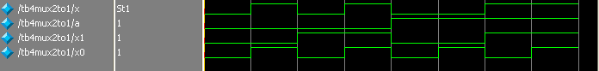
Gate Level Modeling (cont’)
ex) 2:1 Mutiplexer
X1
t2
X
X0
t3
A
t0
t1

Slide 16
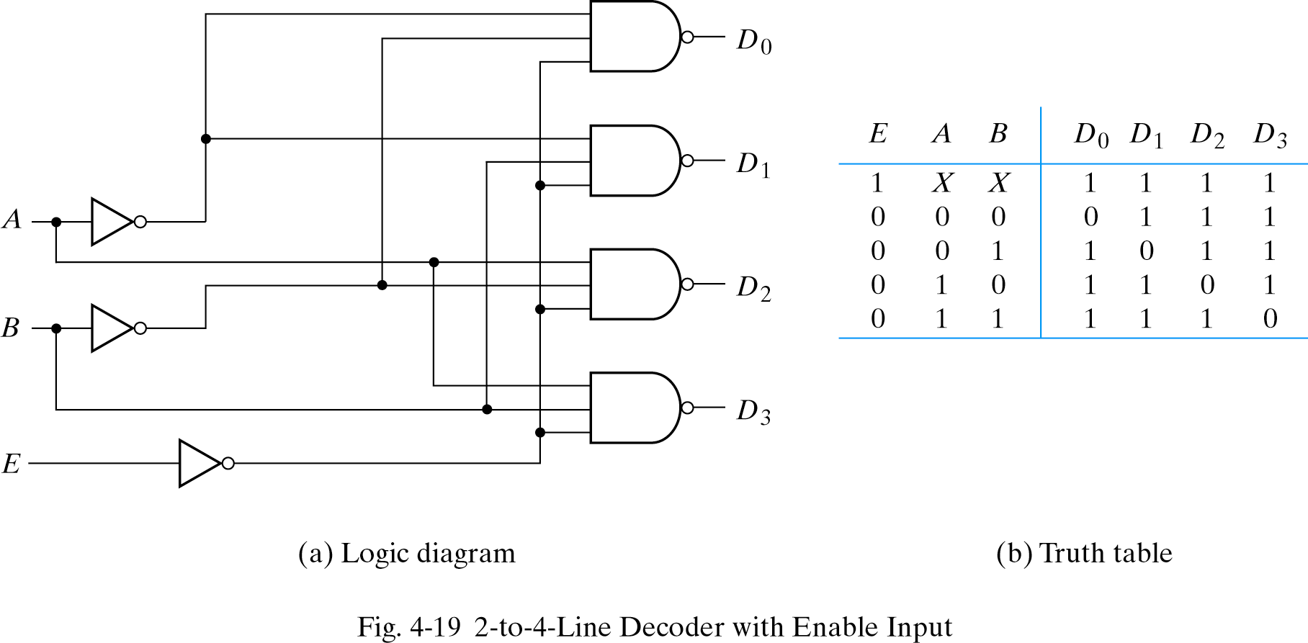
Gate Level Modeling (cont’)
ex) 2:4 Decoder with Enable
outv[3]
outv[2]
inv[1]
outv[1]
inv[0]
outv[0]
ena

Slide 17
Gate Level Modeling (cont’)
ex) 2:4 Decoder with Enable
ena | inv[1] | inv[0] | outv[3] | outv[2] | outv[1] | outv[0]
0 | X | X | 0 | 0 | 0 | 0
1 | 0 | 0 | 1 | 0 | 0 | 0
1 | 0 | 1 | 0 | 1 | 0 | 0
1 | 1 | 0 | 0 | 0 | 1 | 0
1 | 1 | 1 | 0 | 0 | 0 | 1

Slide 18
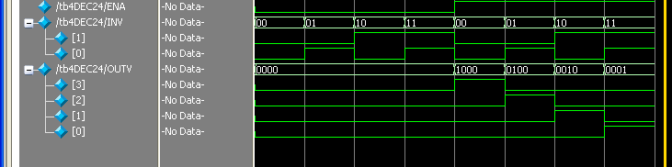
Gate Level Modeling (cont’)
ex) 2:4 Decoder with Enable

Slide 19
Dataflow Level Modeling (cont’)
ex) 2:1 Mutiplexer
module mux2to1 (A, X1, X0, X);
input A;
input X1;
input X0;
output X;
wire A;
wire X1;
wire X0;
wire X;
wire t0;
wire t1;
wire t2;
wire t3;
not not00 (t0, A);
not not01 (t1, t0);
and and00 (t2, t1, X1);
and and01 (t3, t0, X0);
or or00 (X, t2, t3);
endmodule
X1
X
X0
A
module mux2to1 (A, X1, X0, X);
input A, X1, X0;
output X;
wire A, X1, X0, X;
assign X = A ? X1 : X0;
endmodule

Slide 20
Dataflow Level Modeling (cont’)
ex) 2:1 Mutiplexer
module mux2to1 (A, X1, X0, X);
input A;
input X1;
input X0;
output X;
wire A;
wire X1;
wire X0;
wire X;
wire t0;
wire t1;
wire t2;
wire t3;
not not00 (t0, A);
not not01 (t1, t0);
and and00 (t2, t1, X1);
and and01 (t3, t0, X0);
or or00 (X, t2, t3);
endmodule
X1
X
X0
A
module mux2to1 (A, X1, X0, X);
input A, X1, X0;
output X;
wire A, X1, X0, X;
assign X = A ? X1 : X0;
endmodule

Slide 21
Dataflow Level Modeling (cont’)
ex) 2:4 Decoder with Enable
module DEC24 (ena, inv, outv);
input ena;
input [1:0] inv;
output [3:0] outv;
wire ena;
wire [1:0] inv;
wire [3:0] outv;
assign outv[3] = ~inv[1] & ~inv[0] & ena;
assign outv[2] = ~inv[1] & inv[0] & ena;
assign outv[1] = inv[1] & ~inv[0] & ena;
assign outv[0] = inv[1] & inv[0] & ena;
endmodule
outv[3]
outv[2]
inv[1]
outv[1]
inv[0]
outv[0]
ena

Slide 22
Dataflow Level Modeling (cont’)
ex) 2:4 Decoder with Enable
module DEC24 (ena, inv, outv);
input ena;
input [1:0] inv;
output [3:0] outv;
wire ena;
wire [1:0] inv;
wire [3:0] outv;
assign outv[3] = ~inv[1] & ~inv[0] & ena;
assign outv[2] = ~inv[1] & inv[0] & ena;
assign outv[1] = inv[1] & ~inv[0] & ena;
assign outv[0] = inv[1] & inv[0] & ena;
endmodule
outv[3]
outv[2]
inv[1]
outv[1]
inv[0]
outv[0]
ena

Slide 23
Lab Session Syllabus
숙제 제출 요령
레포트로 작성하여 수업시간 시작전 제출
1인 1조
레포트 구성
표지
verilog program
결과 waveform (식별 가능하게)
결과 waveform 원인 분석
구현시 어려웠던 점

